Slide 1
Cornerstone City Church Peninsula Plus Community Hoo Are Ya
14th January 2024

Slide 2


Slide 3


Slide 4


Slide 5
Turn It Up
CCLI Song # 6621485
Andy Harrison
© 2012 Planetshakers Ministries Int. Inc. (Admin. by Song Solutions www.songsolutions.org)
For use solely with the SongSelect® Terms of Use. All rights reserved. www.ccli.com
CCLI Licence No. 33265

Slide 6
1/6
You are here as we lift You up
You are riding on our praise
Be enthroned over everything
You are seated in our praise

Slide 7
2/6
This is prophetic I can feel it in the air
We lift our praise and You change the atmosphere
With hearts open now everybody singing out
(Oh)
(I am free)

Slide 8
3/6
Turn it up this sound of praise
Make it louder than any other
Lift Him up and shout His name over all

Slide 9
4/6
As we praise I can feel the change
As Your presence now invades
Hear the sound of the broken chains
Prison doors are giving way

Slide 10
5/6
Our praise goes up
Your rain comes down
(REPEAT)

Slide 11
6/6
With shouts of praise we celebrate
King of glory enter in
You are riding on our praise oh Lord

Slide 13
Goodness Of God
CCLI Song # 7117726
Ben Fielding | Brian Johnson | Ed Cash | Jason Ingram | Jenn Johnson
© 2018 Capitol CMG Paragon (Admin. by Capitol CMG Publishing)
Fellow Ships Music (Admin. by Essential Music Publishing LLC)
So Essential Tunes (Admin. by Essential Music Publishing LLC)
SHOUT! Music Publishing Australia (Admin. by SHOUT! Music Publishing UK)
Bethel Music Publishing (Admin. by Song Solutions)
For use solely with the SongSelect® Terms of Use. All rights reserved. www.ccli.com
CCLI Licence No. 33265

Slide 14
1/4
I love You Lord
Oh Your mercy never fails me
All my days
I've been held in Your hands
From the moment that I wake up
Until I lay my head
I will sing of the goodness of God

Slide 15
2/4
All my life You have been faithful
All my life You have been so so good
With every breath that I am able
I will sing of the goodness of God

Slide 16
3/4
I love Your voice
You have led me through the fire
In darkest night
You are close like no other
I've known You as a father
I've known You as a friend
I have lived in the goodness of God

Slide 17
4/4
Your goodness is running after
It’s running after me
Your goodness is running after
It’s running after me
With my life laid down
I’m surrendered now
I give You everything
Your goodness is running after
It's running after me

Slide 19
Million Little Miracles
CCLI Song # 7171580
Brandon Lake | Chris Brown | Steven Furtick
© 2021 Music by Elevation Worship Publishing (Admin. by Essential Music Publishing LLC)
Bethel Music Publishing (Admin. by Song Solutions)
Brandon Lake Music (Admin. by Song Solutions)
Maverick City Publishing Worldwide (Admin. by Song Solutions)
For use solely with the SongSelect® Terms of Use. All rights reserved. www.ccli.com
CCLI Licence No. 33265

Slide 20
1/7
All my life I've been carried by grace
Don't ask me how 'cause I can't explain
It's nothing short of a miracle I'm here
I've got some blessings that I don't deserve
I've got some scars but that's how you learn
It's nothing short of a miracle I'm here

Slide 21
2/7
I think it over and it doesn't add up
I know it comes from above

Slide 22
3/7
(I've got) miracles on miracles
A million little miracles
Miracles on miracles
Count your miracles
1-2-3-4 I can't even count 'em all

Slide 23
4/7
You held me steady so I wouldn't give up
You opened doors that nobody could shut
I hope I never get over what You've done
I wanna live with an open heart
I wanna live like I know who You are
I hope I never get over what You've done

Slide 24
5/7
It's not coincidence and it's not luck
I know it comes from above

Slide 25
6/7
(I've got) miracles on miracles
A million little miracles
Miracles on miracles
Count your miracles
1-2-3-4 I can't even count 'em all

Slide 26
7/7
I can't even I can't even count 'em all
I can't even I can't even count 'em all
I can't even I can't even count 'em all 1-2-3-4 I can't even count 'em all

Slide 27
I Love You Lord (To My King)
Gatherhouse Music, Ryan Kennedy, Durell Comedy

Slide 28
1/6
You invite me
To sit down at Your table
Where I can taste and I can see
That You are good
and You are always faithful
To welcome me
The least of these

Slide 29
2/6
You bring beauty out of the ashes
To restore and to redeem
So I have come to pour out all my oil
All I have, this offering

Slide 30
3/6
I love You Lord, I love You
And I want to sing a sweet sweet melody
To tell You, that I love You
Let it be a sweet sweet melody
To my King

Slide 31
4/6
You inhabit the praises of Your people
So I know You're here, right now
With Your Spirit stirring all around me
Before Your glory, I bow

Slide 32
5/6
In my coming and my going
I will praise You
From the evening through the morning
I will praise You
When I rise and when I fall
I will praise You through it all
I will sing a love song to my King

Slide 33
6/6
When I'm lonely and I'm doubting
I will praise You
On the mountain when I'm shouting
I will praise You
When I rise and when I fall
I will praise You through it all
I will sing a love song to my King

Slide 34
1/1
I love You Lord
And I lift my voice
To worship You
O my soul rejoice
Take joy my King
In what You hear
May it be a sweet sweet sound
In Your ear

Slide 36


Slide 37
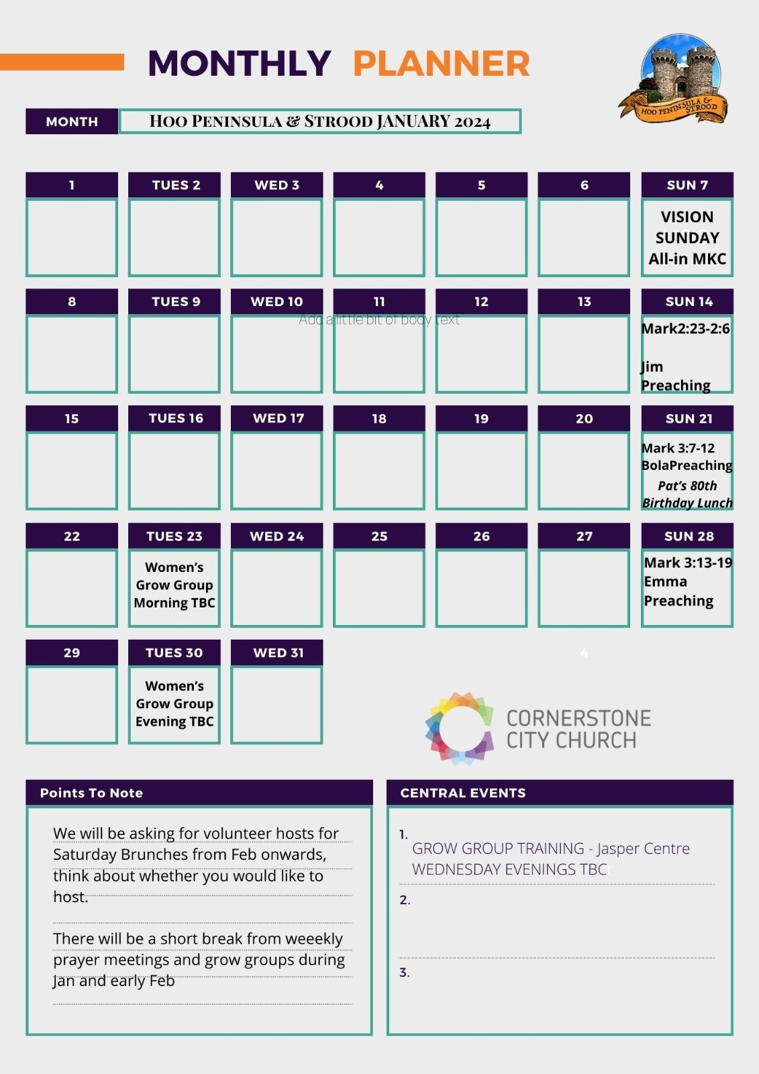

Slide 38


Slide 39


Slide 40


Slide 41
My Worship
CCLI Song # 7098688
Philip Nathan Thompson | Zenzo Matoga
© 2017 Integrity Worship Music (Admin. by Integrity Music Ltd)
Phil Thompson Worship (Admin. by Integrity Music Ltd)
Zenzo Matoga Music (Admin. by Integrity Music Ltd)
For use solely with the SongSelect® Terms of Use. All rights reserved. www.ccli.com
CCLI Licence No. 33265

Slide 42
1/3
You Lord
You are worthy
And no one can worship You for me
For all of the things You've done for me
And no one can worship You for me

Slide 43
2/3
Here's my worship
All of my worship
Receive my worship
All of my worship
(REPEAT)

Slide 44
3/3
And I will not be silent
I will always worship You
As long as I am breathing
I will always worship You

Slide 45
2 Corinthians 14 May the grace of the Lord Jesus Christ, and the love of God, and the fellowship of the Holy Spirit be with you all

